Slide 1
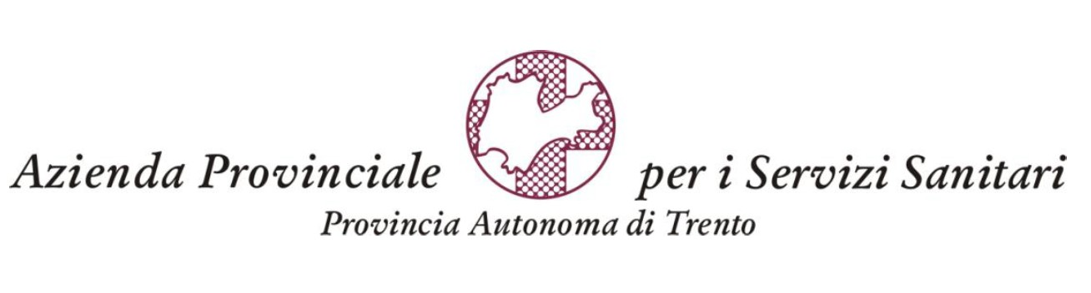


MANIFESTAZIONI NEUROLOGICHE
NEI PAZIENTI OSPEDALIZZATI
Dott.ssa Ottaviani Donatella
NEURO-COVID: complicanze neurologiche dell’infezione Sars-CoV-2
09 settembre 2021
Centro Congressi Interbrennero
Via Innsbruck, 15 – Trento

Slide 2

Possible direct effects of the virus on the nervous system, para-infectious or post-infectious immune-mediated disease, and neurological complications of the systemic effects of COVID-19
Encephalitis
Encephalopathies
Myelities
ADEM
Strokes
Deep vein thrombosis
Smell and taste disorders
Headache
Peripheral nervous system
Muscle disease
Seizures and SE
Generalized myoclonus

Slide 3
COHORT DESCRIPTION
 |  | 1^ wave | 2^ wave* | Mean age (SD)
Total patient Covid+ | 1069 | 477 | 593 | /
Total Neuro-Covid patients | 95 (9%) | 52 | 43 | 62.97 (14.43)
*05/08/20-31/12/20
mean age M = 64.25
mean age F = 60.89
mean age 1^ = 63.42
mean age 2^ = 62.38

Slide 4
NEUROLOGIC MANIFESTATIONS OF COVID-19

Slide 5
NEUROLOGIC MANIFESTATIONS OF COVID-19 IN 1^ AND 2^ WAVE

Slide 6
LABORATORY AND INSTRUMENTAL TESTS

Slide 7
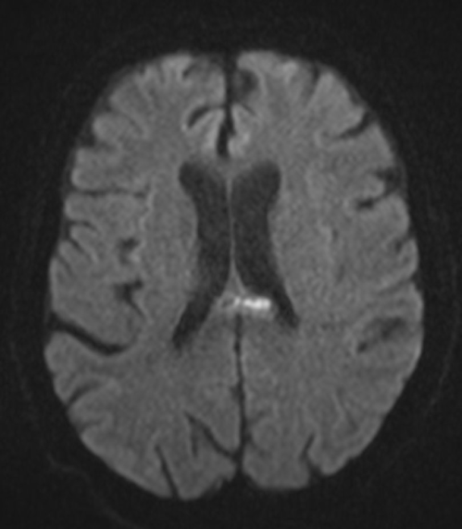
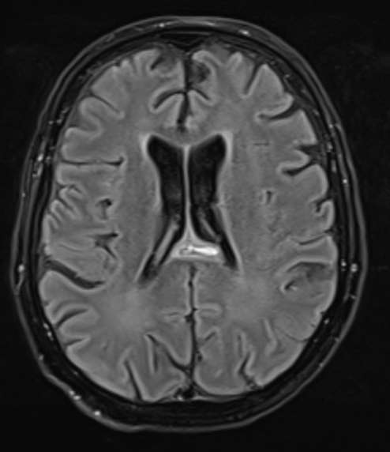
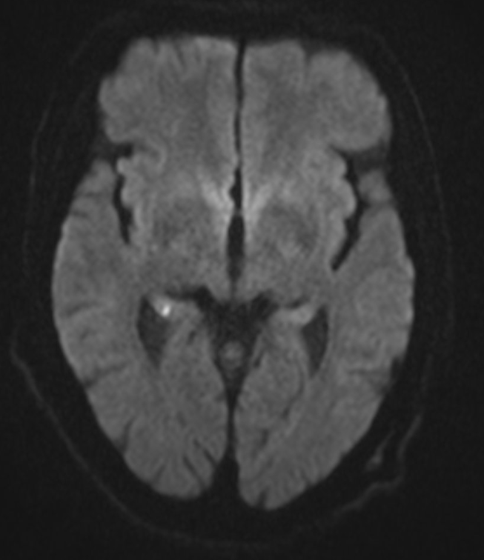
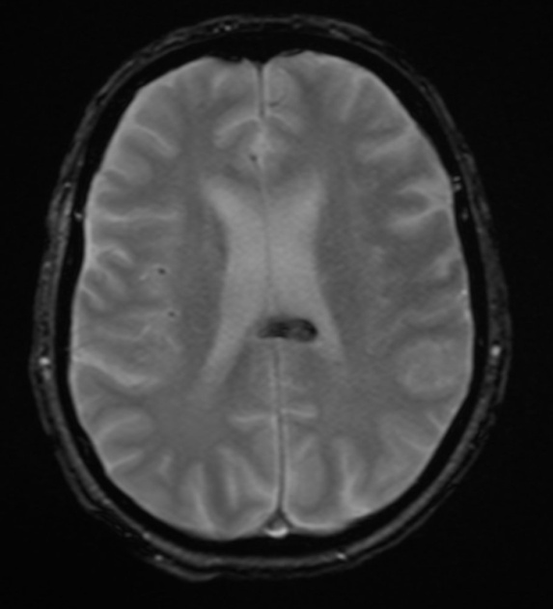
SOME MRI FINDINGS
#1 splenium hemorragic injury
#2 right hippocampal ischemic lesion

Slide 8
FARMACOLOGICAL TREATMENT OF NEURO-COVID PATIENTS

Slide 9
COMORBIDITIES OF NEUROCOVID PATIENTS

Slide 10
NEUROLOGIC MANIFESTATIONS OF COVID-19 ACCORDING TO SEX
Significant difference in access to hospitalization in intensive care depending on sex (X²=13.30; gl=1; p<0.001)

Slide 11
NEUROCOVID FEMALE AND MALE PATIENTS WITH BAD OUTCOME
Mean age (SD) = 74 (8.4)

Slide 12
PREMORBIDITIES AND NEUROLOGICAL MANIFESTATIONS AS POSSIBILE RISK FACTORS

Slide 13
CONCLUSIONS
The prevalence of neurologic manifestations in our cohort (9%) is in keeping with data from previous studies, which reported overall neurological complications in 3.5%-13.5% of hospitalized patients
Delirium and CIN were most common in the I wave, while strokes were most common in the II wave
  ICU patients from the second wave were not included
Cerebral hemorrhagies were more frequent than ischemic strokes, as a negative prognostic factor
Strokes, seizures and GBS were more prevalent in the second wave when compared with the first wave (p < 0.001)

Slide 14
CONCLUSIONS
Gender significant difference in the three most common neurological manifestation of Covid-19 (delirium, stroke and impaired consciousness)
Association between gender and admission to the ICU
Neurologic manifestations in COVID patients who died where more tipically related to the the involvement of CNS, and not necessarly related to the severity of patient’s disease
We didn’t observe a clear correlation between mortality and previous neurological condition

Slide 15
CONCLUSIONS
High prevalence of hypogeusia and hyposmia were most frequently reported in the first wave than second
  Data were collected at the follow-up of the patients with neurologic complications
  More common in non hospitalized patients
  Underestimated ? (possibly because patients were firstly assessed by doctors not specialized in neurology)

Slide 16
CHALLENGES
Managing an overwhelming number of patients with a highly contagious infection
Absence of comprehensive studies such as cerebrospinal fluid (CSF)/tissue analysis and imaging
Need for a longitudinal follow-up to support the reliability of our data

Slide 17
NEURO-COVID: ABOUT THE FUTURE
MORE STUDIES ARE NEEDED TO BETTER UNDERSTAND THE ROLE OF SARS-COV 2 IN COVID PATIENTS WHO DEVELOPED NEURO-COVID:
  Progetto Neuro-Covid SIN
  Follow-up study of not hospetalized patients with neurological long-covid (in collaboration with CeRiN)
  Follow-up study of survivors from first wave (in collaboration with CeRiN)
  Euregio

Slide 18

THANKS TO:
Neuro-Covid team:
Chiara Longo
Elena Baruzzo
Costanza Papagno
Federica Boso
Umberto Rozzanigo
Sandra Magnoni
Bruno Giometto
&
Susanna Cozzio and her team
Giovanni Pedrotti and his team
Renzo Girardello and his team
Neurology Unit: collagues and neurophisological technicians
Nurses and OSS

